Slide 1


Understanding before taking action
Correction coefficient
made simple
for staff in active status

Slide 2
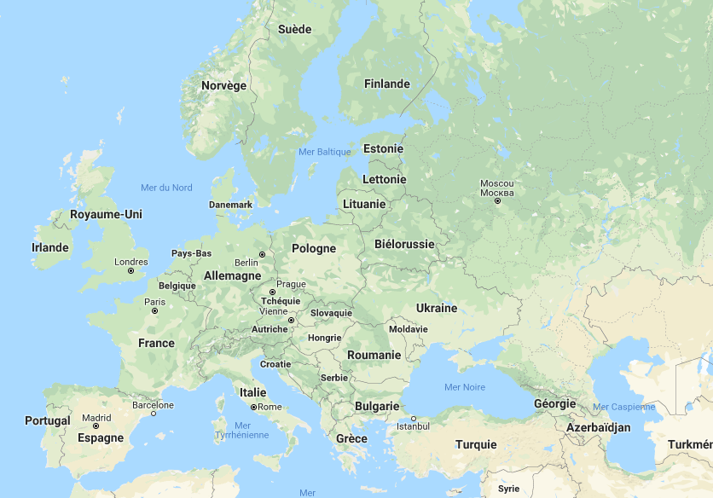
EU-staff are posted in various places of employment all over Europe and throughout the world.
In order to ensure that they enjoy equivalence of purchasing power, their salary is weighted at a rate above or below 100 %, depending on the cost of living in their place of employment.
This rate is called a correction coefficient (cc).

Slide 3
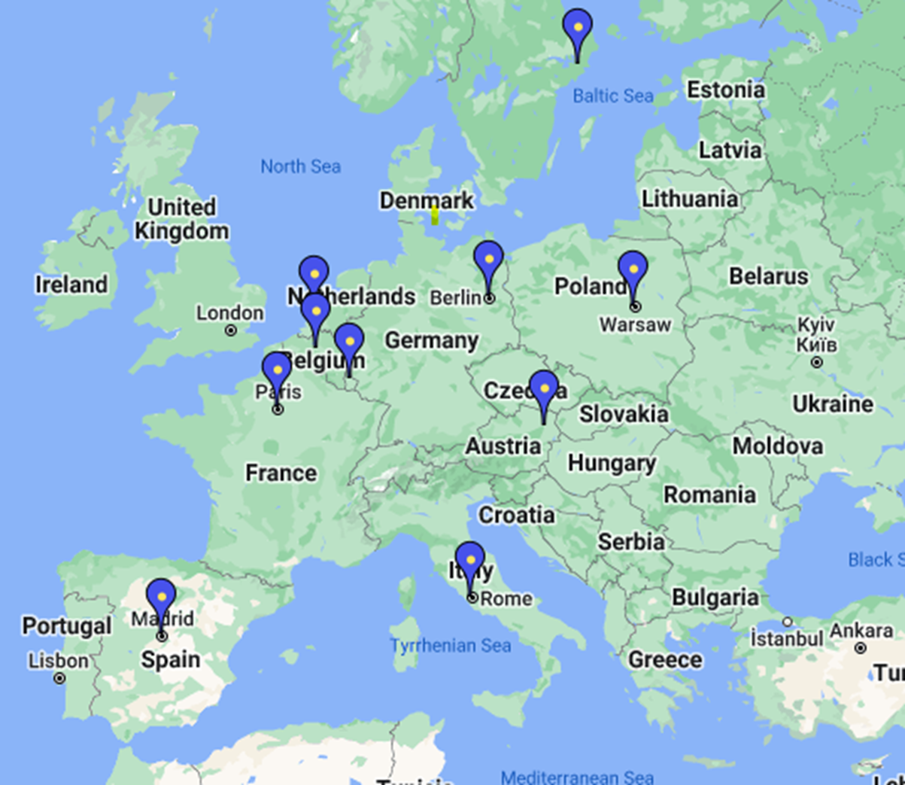
Yearly updates, calculated by Eurostat and rubber-stamped by the Commission, are meant to ensure parallel evolution of EU-salaries with those of national civil servants in central government of a sample of 10 Member States (see map, blue markers)
They are not an ‘indexation’ linked to inflation in your place of employment.

Slide 4
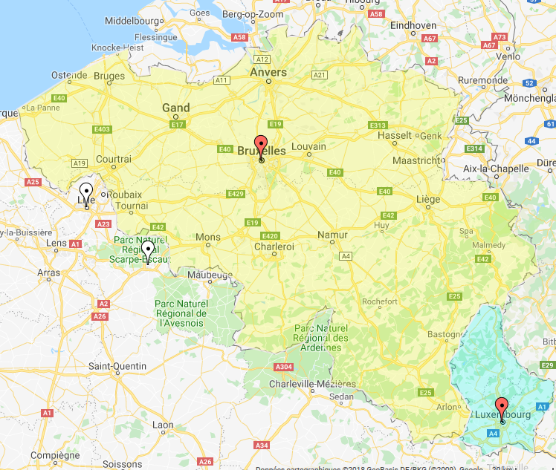
The reference city (base = 100) for fixing correction coefficients is Brussels, the capital city of Belgium.
Capital cities of Member States outside Belgium (and Luxembourg) get a weighting, set above or below 100.
Eurostat conducts Family Budget Surveys (FBS) in Brussels to establish the pattern of consumption of an average EU-staff household.

Slide 5
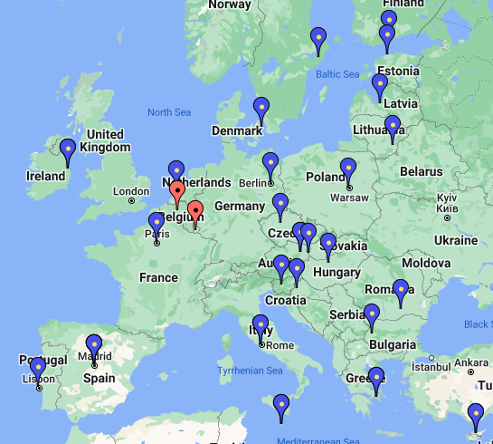
Every year, Eurostat calculates a correction coefficient for each Member State (except for BE and LU).
To this effect, it conducts periodically a Family Budget Survey in the capital city of each Member State (except for NL, where The Hague is considered) (blue markers).

Slide 6
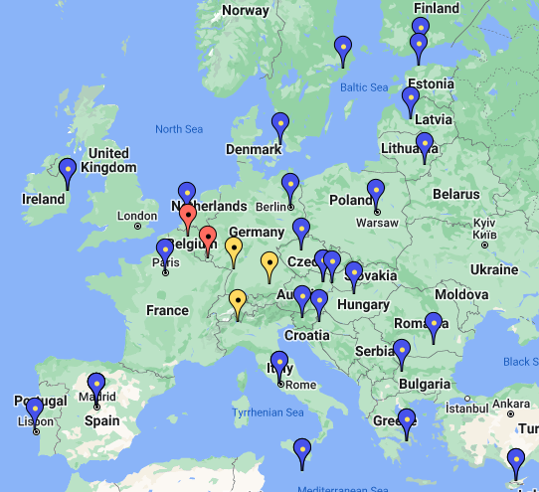
The correction coefficient fixed in the capital city applies to all EU-staff serving within the same country.
However, a different correction coefficient can be fixed for certain places of employment other than the capital city. This possibility is currently used in three cases only (yellow markers).

Slide 7
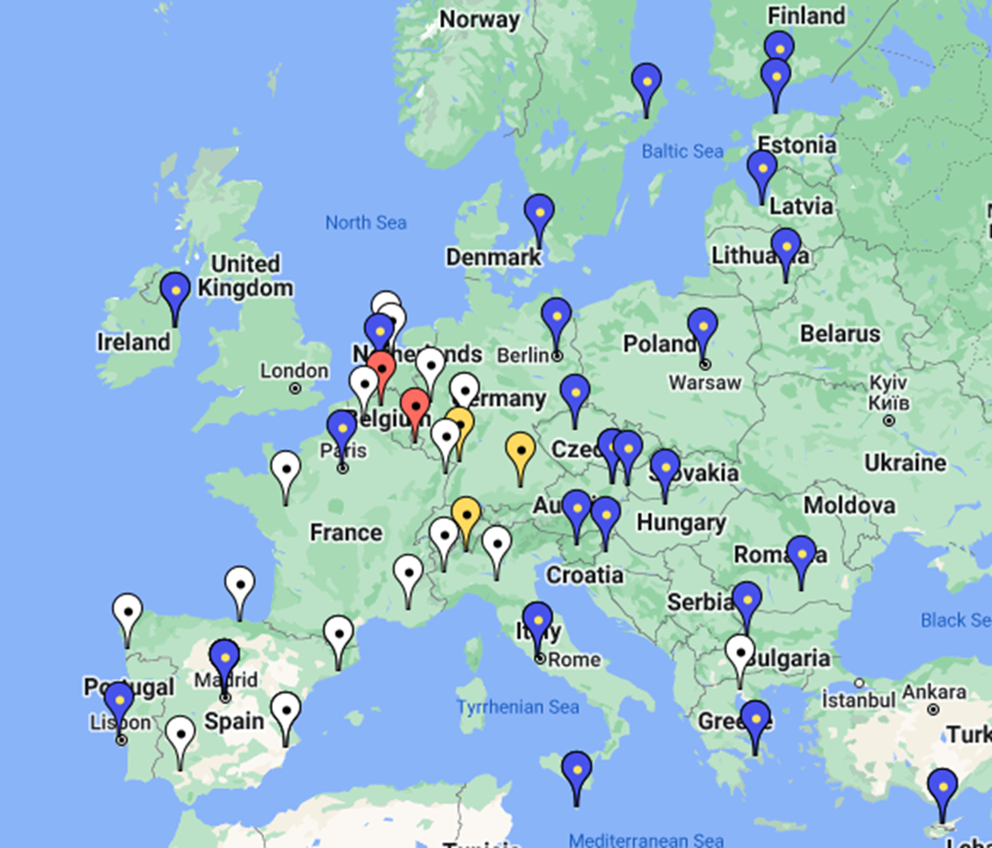
Most other places of employment have no correction coefficient of their own (white markers). This implies that they are subject to the cc of the capital city of their country.
(e.g. for Italy: for Turin or Parma, the Rome cc applies, as opposed to Varese, which has a cc of its own).

Slide 8
Since the 2014 Reform of the Staff Regulations, the creation of a correction coefficient specific to a duty station (other than the capital city) can be enacted by the Commission by way of delegated acts.

Slide 9
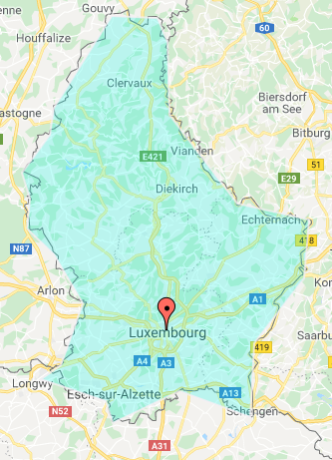
And what about Luxembourg ?
Purely indicative data collected by Eurostat (2022) show that the cost of living in Luxembourg is by ca 20% higher than the one in Brussels.

Slide 10
Why then there is no correction coefficient for Luxembourg ?
Well, the answer is formal: This is not allowed by the Staff Regulations:
Article 64
No correction coefficient is applicable in Belgium and Luxembourg, […]
ANNEX XI
Article 3 (5)
No correction coefficient shall be applicable in Belgium and Luxembourg. […]

Slide 11
Therefore, Eurostat has no legal basis to conduct a Family Budget Survey for Luxembourg.
Considering LU as by definition equal to BE is plainly the expression of the political will of the EU-legislator.

Slide 12
Can the ‘place of employment’ Luxembourg-City be extracted from the country of Luxembourg and be given a cc ?

Slide 13
The answer is: No
Firstly, because the above-mentioned (slide 10) articles are clear: The cc-ban applies to the whole territory of the Grand-Duchy of Luxembourg.
Secondly, because, even in ‘normal’ cases, a weighting which applies to the staff serving within a country is calculated on its capital city. And the capital city cannot be detached from the rest of the country to be given a different one.

Slide 14
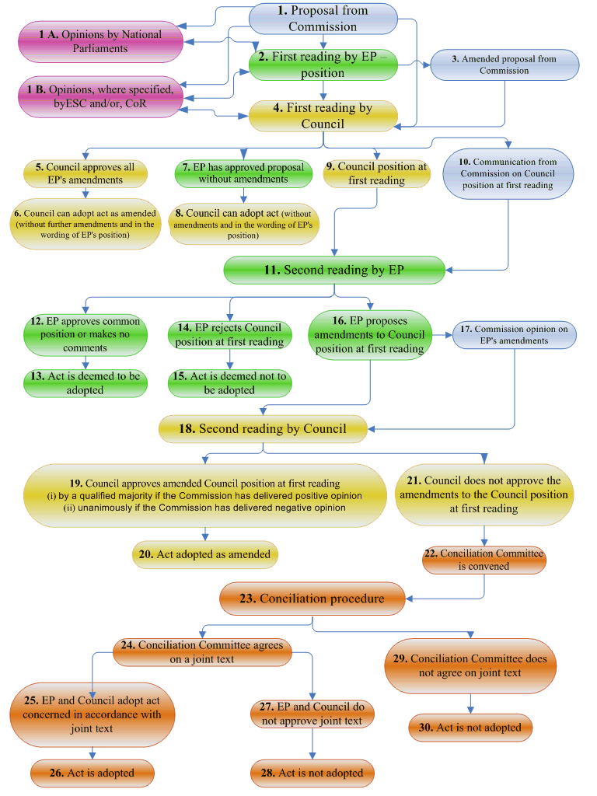
Therefore, the only way to create a correction coefficient for Luxembourg is to amend the Staff Regulations.
Which requires no less than an ⬅Ordinary legislative procedure.
Proposal from Commission
European Parliament
Council
→co-decision←
There is no way around it …

Slide 15


Experience has shown that a Staff Regulations reform is full of risks.
The price to pay will be high.
We, and the most vulnerable among us in particular, have more to lose than to gain.
To counter attacks to come against our conditions of employment, do the right thing now: As a first step, strengthen the negotiating ability of those Unions which tell you the full truth.

